Slide 1

AUTOMATIC ATTENDENCE SYSTEM BY USING FACE RECOGNITION
Presented By :
Sujoy Nandi (Roll no: 434122010061)

Slide 2
TABLE OF CONTENT
INTRODUCTION
WHY FACE RECOGNITION
METHODOLOGIES USED IN FACE RECOGNITION
MODULES USED IN FACE RECOGNITION
ADVANTAGES AND DISADVANTAGES OF FACE RECOGNITION
APPLICATIONS
CONCLUSION

Slide 3
INTRODUCTION
Face Recognition Attendance System is developed for the faculty to maintain attendance record.
It is easier and convenient method than taking attendance manually in classroom.
It uses facial recognition technology to identify the person’s facial features and automatically mark attendance for student with their student ID ,student name in database which is very fast than manual method.

Slide 4
WHY FACE RECOGNITION
Highly accurate and high enrolment and verification rates.
Does not require an expert.
Using existing hardware infrastructure.
Allows to perform passive identification.

Slide 5
METHODOLOGIES USED IN FACE RECOGNITION
Data Acquisition
Feature Extraction
Classification
Match/No Match
Accept/ Reject

Slide 6
MOTIVATION
In most educational institutions the attendance taken manually.
It is not only time consuming but it is also unsecure and unreliable and it can be lost at any time.
To overcome these problem we have developed system which is automatic attendance system by using face recognition , it is fully responsive where faculties can use it very easily in different computer.
In this system records are kept safe and secure and the attendance information of all students can be accessed easily and without time consuming.

Slide 7
PROPOSED SYSTEM
To overcome the drawbacks of the existing system , the proposed system has been evoled.
Here , our project aims to reduce the paper work and saving time to generate accurate results from the student attendance.
The system provides with best user interface and no malpractice is entertained like proxy.
The efficient reports can be generated by using this proposed system.
We can retrieve data when ever it’s required with consuming less amount of time.

Slide 8
ALGORITHM
Image acquisition
Histogram normalization
Noise removal
Skin classification
Face detection
Face recognition
Attendance

Slide 9



IMAGE ACQUISITION
Image is acquire from the camera that is connect above the board. A camera capture image after every two minutes and send this image to the computer for processing as shown in fig

Slide 10
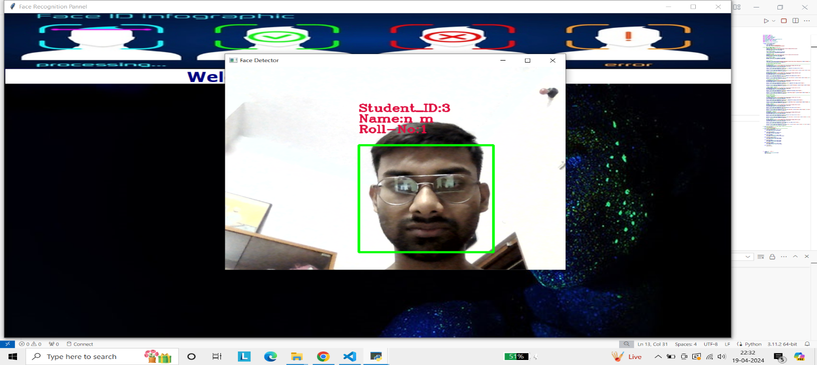
Face Detection
In this stage faces are detected by marking the rectangle on the faces of the student as shown in fig .
After the detection of faces from the next step is cropping of each detected face.

Slide 11
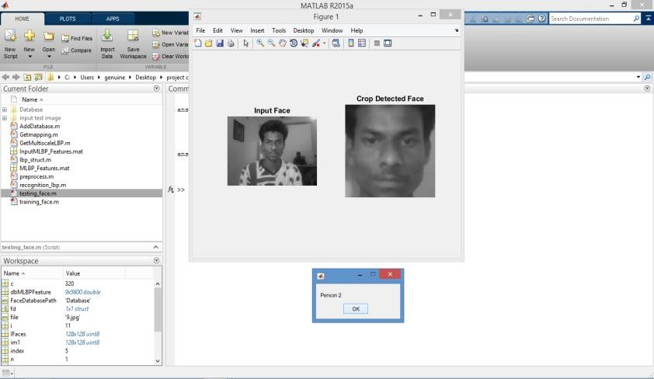
Face Recognition and Attendance
After the face detection next step is face recognition this can be done by cropping the detected face and compare with the database. In this way face of student. Verified one by one and attendance is marked on the computer screen as shown in fig.

Slide 12
APPLICATIONS
Replacement of PINS, physical tokens.
Voting system.
Computer security. Banking using ATM.
Security in schools.
Airlines use.
Device security etc...

Slide 13
ADVANTAGES
It saves there time and efforts.
The software stores the faces that are detected and automatically marks attendance.
The system is convenient and secure for the user.
The software can be used for security purposes in organization and secured zones.

Slide 14
DISADVATNATGES
It can only detect face from a limited distance
At first we have to take our picture and train the data otherwise system can’t detect our face.

Slide 15
CONCLUSION
In this system we have implemented an attendance system, section or laboratory by which lecturer or teaching assistant an record student’s attendance.
It saves time and effort, especially if it is a lecture with huge number of students..
This attendance system shows the use of facial recognition techniques for the purpose of student attendance and for the further process this record of student can be used in exam related issues.

Slide 16
THANK YOU.

